Slide 1

JUST COMMIT
MINI IMPACT REPORT 2023-2024
WEBSITE: https://justcommit.org
E-LEARNING PLATFORM:
https://community.justcommit.org
INSTAGRAM: instagram.com/jjustcommit
ABOUT US: https://youtu.be/WXTghkZndqI?si=g0P9ir7wv4Xl5C5C NB: MOST VIDEOS ARE OPENED WITH LINKS TO PREVENT INELLECTUAL PROPERTY THEFT

Slide 2
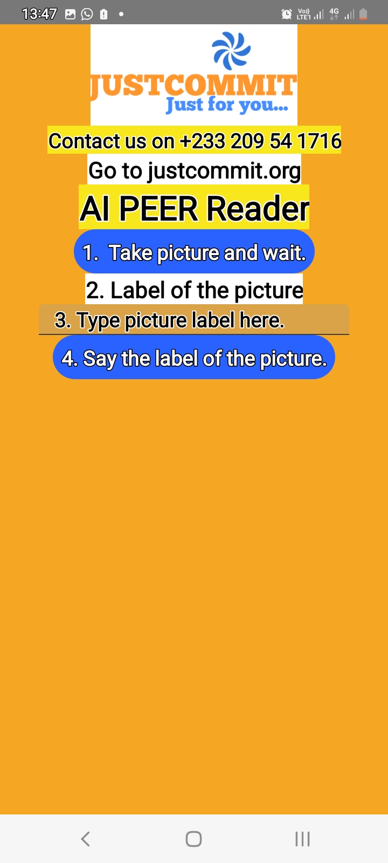
AI PICTURE TO TEXT AND SOUND APP
Video Link:
https://youtu.be/Q5myWwPJcVg?si=5_C2SNzqAjkiQ4U3

Slide 3
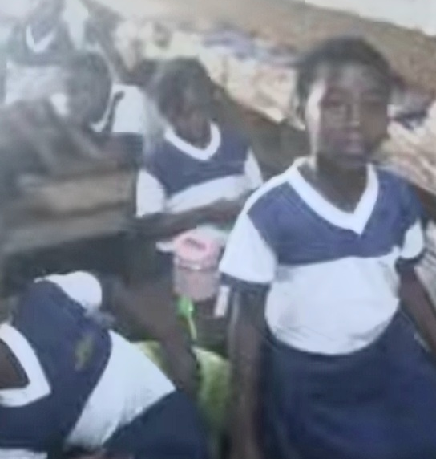
GIRLS IN TECHNOLOGY
CODING CLASSES VIDEO LINKS
https://youtu.be/wlkRhoU4ugE?si=tnzxnASEy4QUxFOi
https://youtu.be/9E5wUOjuUdE?si=tS9gOh31fL6gy67f
https://youtube.com/shorts/sSQ3lLFRzm4?si=5Pl-JkiKPS1o0UyX
CREATING BROWSER:
https://youtube.com/shorts/DPGugX1j2Rw?si=HwtIyJYLe_2VAeQk
ICT TRAINING:
https://youtu.be/AecoLSeSNvg?si=F6tM9LsADD5DVsSN

Slide 4
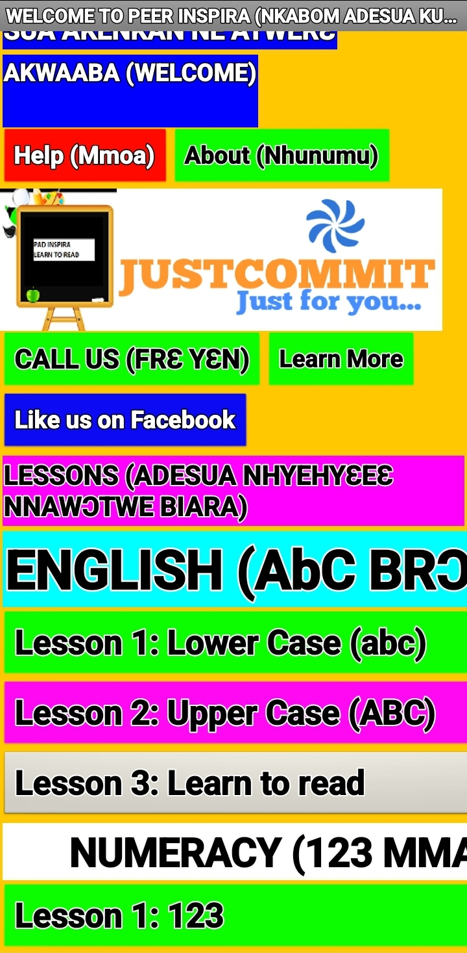
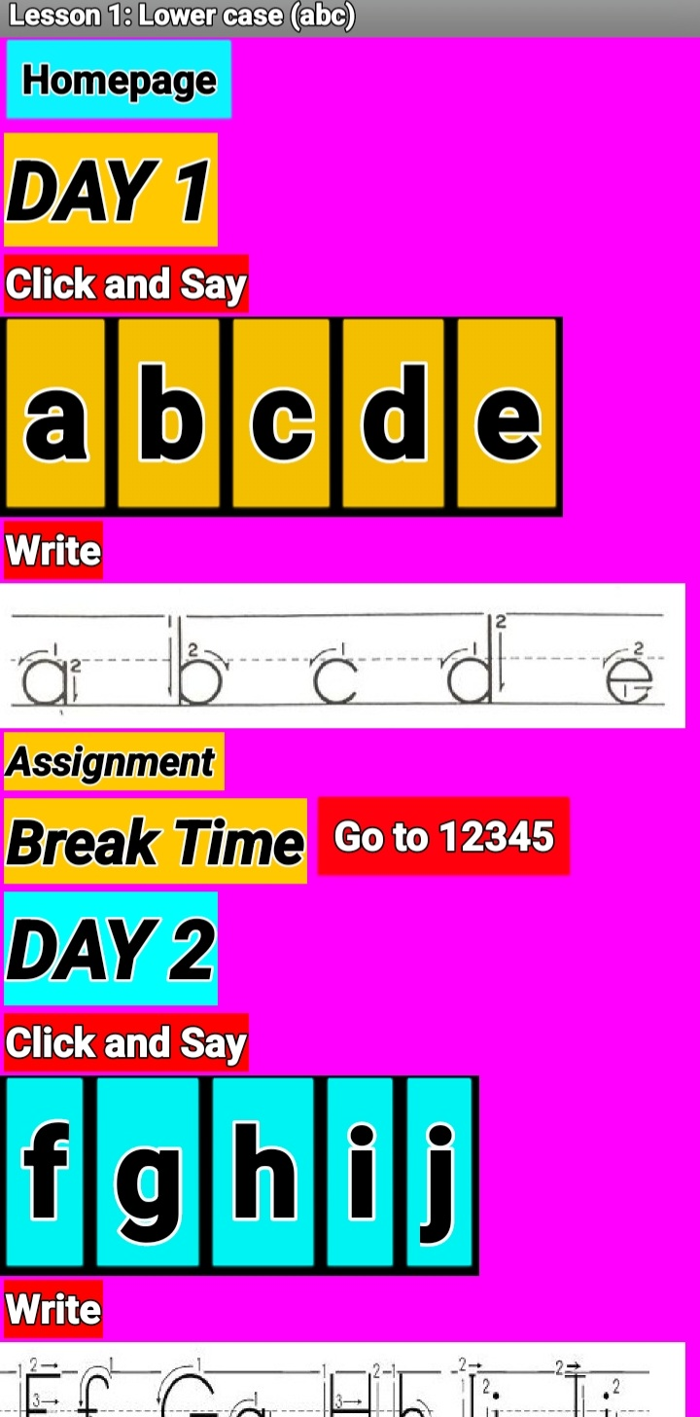
LITERACY & NUMERACY SKILLS VIDEOS
A kid learning with our App:
https://youtube.com/shorts/zWrVA8BGSqc?si=Qw69MLTLi8uLeKhh
Training for Spelling Bee:
https://youtube.com/shorts/Xdl18zzhNRA?si=53z53zexZY4BLkNU_S
We Organized Spelling Bee:
https://youtube.com/shorts/NkkxSqHKBVE?si=OQRvmKtMXZlPPG8Y
Home Lessons: https://youtu.be/0m8sBZnXaM0?si=Z4GYR-DyAO_0znHv

Slide 5
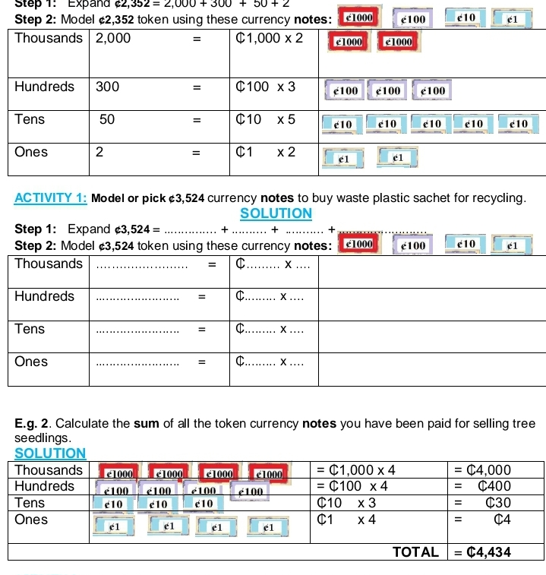
SOME LESSON CONTENTS VIDEO LINK
https://youtu.be/45UfvF-iNW4?si=Aydn3kFrTiQQpezD

Slide 6
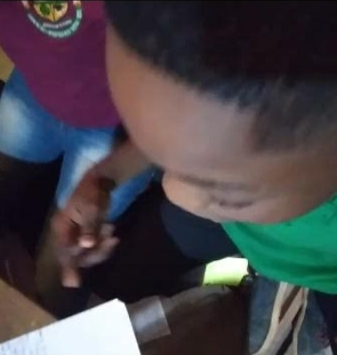
ENTREPRENEURSHIP TRAINING
CREATING BUSINESS MODELS AND POWERPOINT
PRESENTATION:
https://youtu.be/97RYcF-B-So?si=GSLwmMONjzwplUhZ
Training Contents:
https://youtu.be/FjoDRGtP83A?si=89qf1xFcbiLlIly0
Making Products:
https://youtu.be/qggXhTm6ips?si=8YDnbrldrDJeOsqY

Slide 7
MORE LINKS
Montessori Numeracy Lessons at Home:
https://youtube.com/shorts/lmRHxDlnIBk?si=rMMXjrHhEj9x0xWD
With School For Deaf:
https://youtube.com/shorts/hw2j05dH8gg?si=RHi1r_7vDqw6qE9D
Pink Tower Lessons:
https://youtube.com/shorts/onRp7Y1Jis8?si=HubxDwxMBs-TXWd9

